Slide 1
DNSSEC
Alexey Titov, Itzhak Shneler, Shir Bentabou

Slide 2
Our Project
Our project questions the published percentage use and general use of DNSSEC worldwide.
The aim is to give data and statistics about the use of DNSSEC in the domains we have chosen in every country.
It is known that the root servers all use DNSSEC since 2010.
In our work we want to know what is the status in the levels under the root severs.
We have done this by collecting data from DNS queries and processing it.
The resources we got the information about the current usage were:
  Wikipedia
  APNIC - https://stats.labs.apnic.net/dnssec

Slide 3
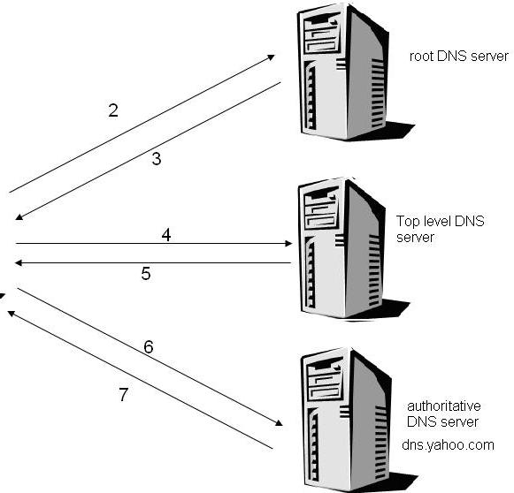





Project Outline
1
2
3

Slide 4
Original Plan
The original plan for our project was:
  Gather domains for every country and popular domains worldwide
  Write python code that runs a DNS query for each domain and checks if the response returned uses DNSSEC
  For every query that is returned without DNSSEC, use Wireshark to sniff the query and response and check where the DNSSEC fell in the response (what level)
  Gather all information and insert into a database
  Compare the information gathered to the information from Wikipedia and APNIC
  Run statistics on the information gathered from the queries

Slide 5
Changes in the Original Plan
After researching and while writing our code, we discovered two websites that help us in the stage of researching the DNSSEC in the queries.
In these websites the request, all the options of response and the stages of the responses can be seen, thus allowing us to see where the usage of DNSSEC fell in the response.
Instead of using wireshark, we used the ‘dig trace’ command.
In order to research where exactly the DNSSEC fell in the response, we used:
  http://dnsviz.net/
In addition to that, many queries had to be handled manually.

Slide 6
Project Phases
The first phase of our project was to gather relevant domains.
We did that using ordinary methods and searches (https://www.alexa.com/topsites).
As planned, we gathered:
  Three domains for (almost) every country, that are specific to the country.
  Ten most popular domains worldwide.
  Three most popular domains for: .net, .org, .eu, .com, .gov
For every country, we checked its statistics in Wikipedia and APNIC website.
The list of domains can be seen here:
https://github.com/advanced-cyber/DNSSEC-Query/blob/master/dnssec.xlsx

Slide 7
Project Phases
The next phase of our project was to write a python code that runs the ‘dig’ and ‘trace’ commands to gather all the interesting information we wanted.
The information gathered using the python code from the queries:
  Usage of the DNSSEC flag in every phase of the response
  The algorithms used in every phase in the query
  The IP’s the response was returned from
After learning all the data we could gather, we ran the dig command using python and gathered the information in two files.
The python code can be seen here:
https://github.com/advanced-cyber/DNSSEC-Query/blob/master/count_trace_results.py
https://github.com/advanced-cyber/DNSSEC-Query/blob/master/count_overall_results.py

Slide 8
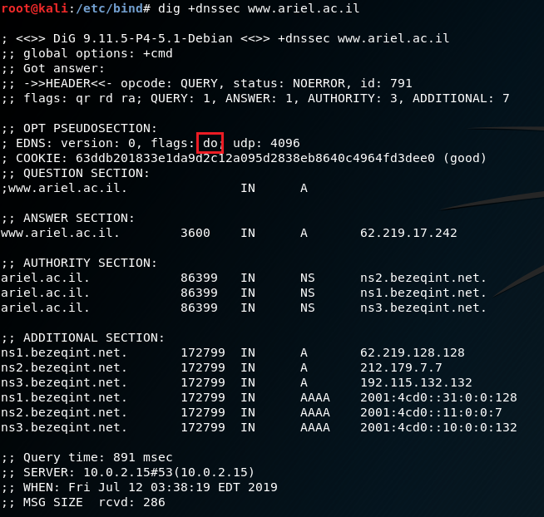
Project Phases
DNSSEC
flag

Slide 9
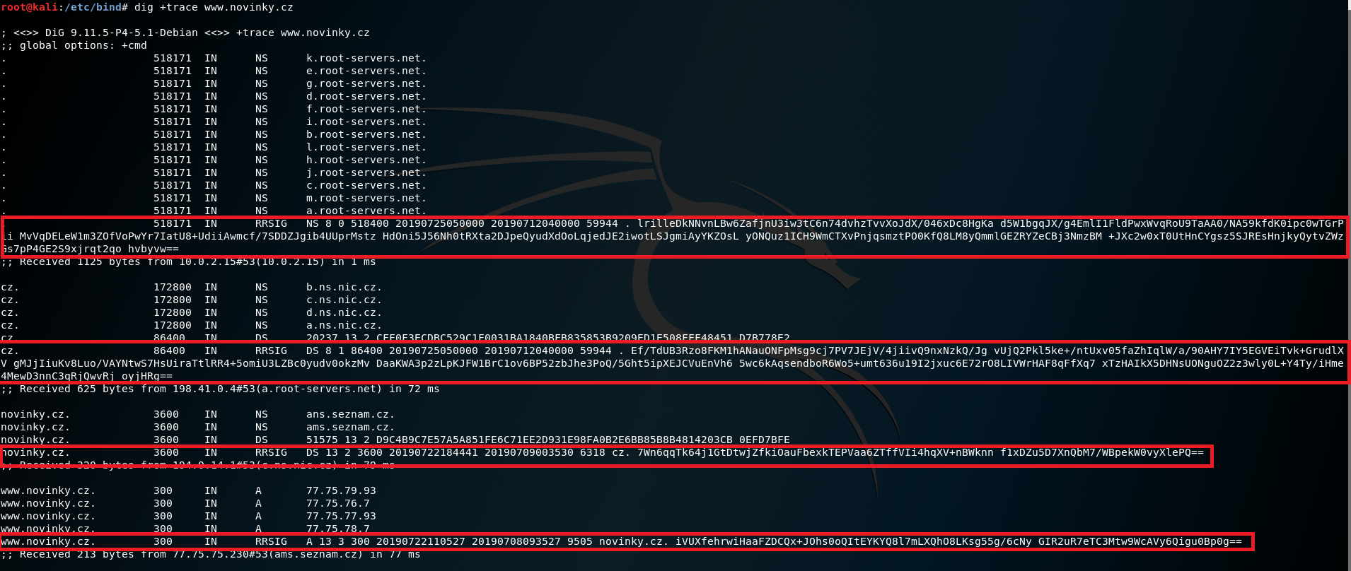
Project Phases
DNSSEC data for every phase

Slide 10
Project Phases
After gathering all the information we could using the code, we used the results in order to further investigate the queries that did not use DNSSEC in their response.
In this file, all the domains that have any false value on their right were further investigated:
https://github.com/advanced-cyber/DNSSEC-Query/blob/master/advanced_cyber/overall_results.csv
The investigation was done using http://dnsviz.net/, and in this stage we documented manually all the results.

Slide 11
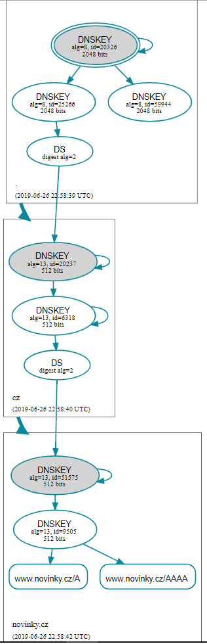
Interesting Insight
There were a few cases that we have seen while researching the requests, we will give an example to each one.
This is an example of a DNS request that returned a response using DNSSEC, www.novinky.cz (Czech Republic):

Slide 12
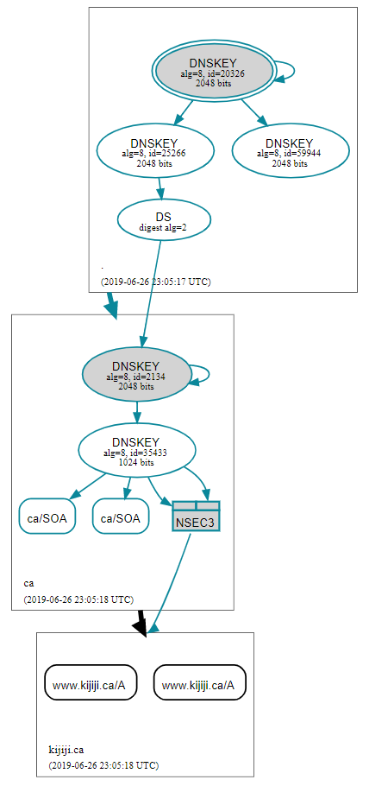
Interesting Insight
This is an example of a DNS query that returned a response using DNSSEC, but the website itself does not use DNSSEC:
www.kijiji.ca (Canada)

Slide 13
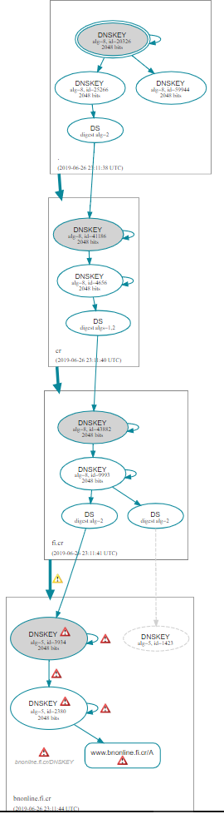
Interesting Insight
This is an example of a DNS query that returned a response using DNSSEC, but the website (here: www.bnonline.fi.cr (Costa Rica)) has many errors. Therefore the command ‘dig +trace’ returns False.

Slide 14
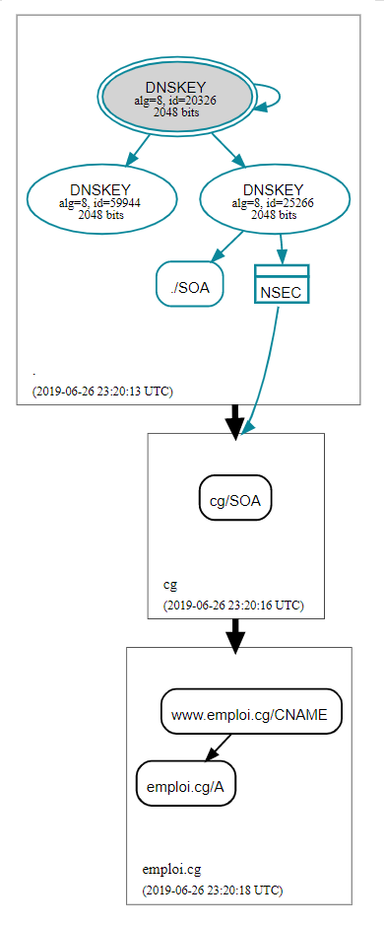
Interesting Insight
This is an example of the case in which the internet country top-level domain does not use DNSSEC, www.emploi.cg (the Republic of the Congo).

Slide 15
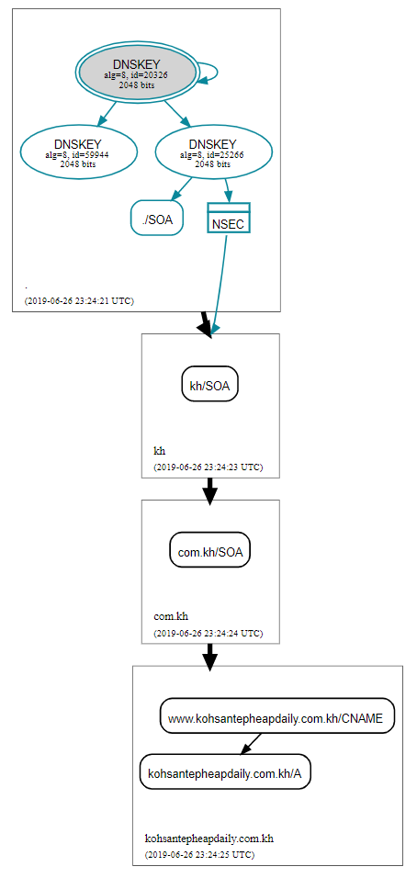
Interesting Insight
This is another example of the previous case, but the trees are different.
www.kohsantepheapdaily.com.kh (Cambodia):

Slide 16
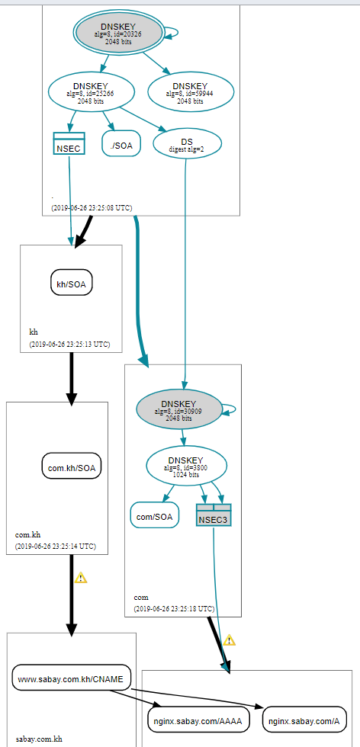
Interesting Insight
In this example, there are two paths, and the path that does not support DNSSEC was chosen. www.sabay.com.kh (Cambodia)

Slide 17
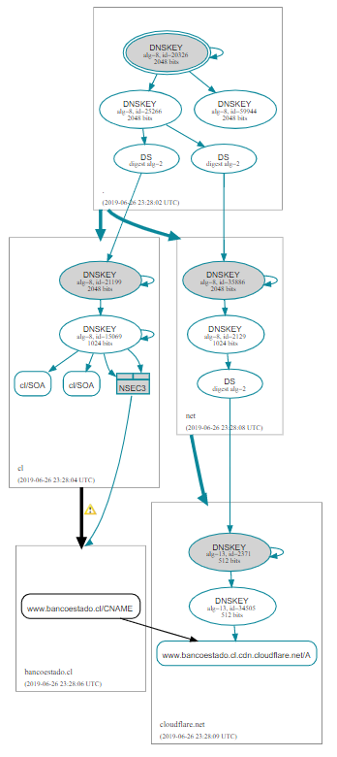
Interesting Insight
This is an example of a query that has two paths. One supports DNSSEC all the way through and the second supports DNSSEC partially.In this example the second path was chosen, and the query supports DNSSEC: www.bancoestado.cl (Chile)

Slide 18
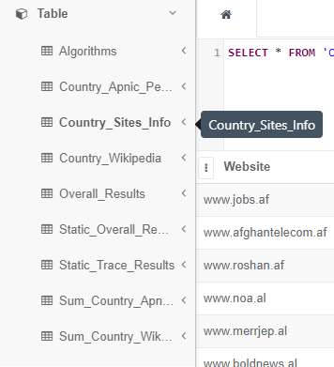
Project Database
After gathering all the information from previous phases, we built the database of our project.
We inserted all the data into the database, in order to do the advanced statistics on the responses of the queries.
We have chosen on online ‘sqlite’ database, sufficient for our needs.

Slide 19
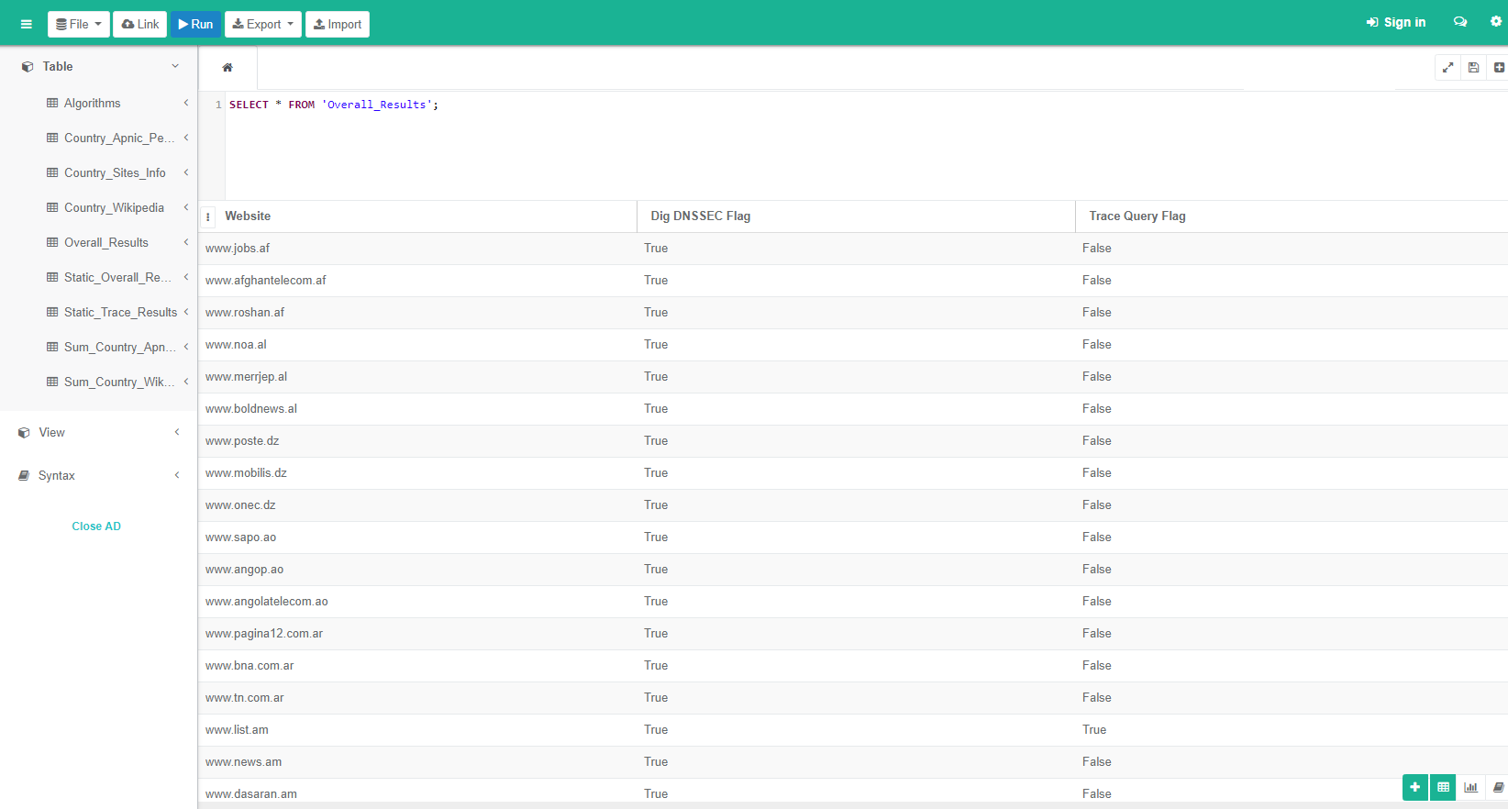
Project Database

Slide 20
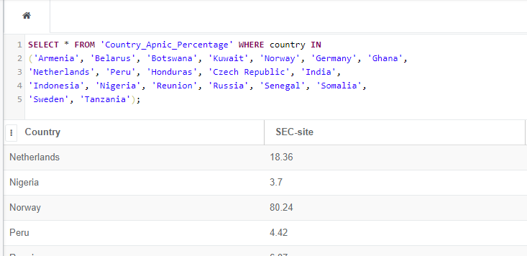
Project Database
Our DB can be found here: https://github.com/advanced-cyber/DNSSEC-Query/blob/master/OVER/static_sqlite.db

Slide 21
Statistics
Data from Wikipedia:
  Number of countries checked overall: 180

Slide 22
Statistics
Data from APNIC:
  Number of countries checked overall: 178 (Macao & Honk Kong = Part of China by APNIC)

Slide 23
Statistics
Overall data from Python code:
  Number of domains checked overall: 544
Left Side – Dig + DNSSEC
Right Side – Dig + Trace
Dig + DNSSEC = Always true because of root level.
(Exception given on Ethiopian sites that did not exist.)

Slide 24
Algorithm Info.
Number | Description | Mnemonic | Zone Signing | Trans. Sec.
0 | Delete DS | DELETE | N | N
1 | RSA/MD5 (deprecated, see 5) | RSAMD5 | N | Y
2 | Diffie-Hellman | DH | N | Y
3 | DSA/SHA1 | DSA | Y | Y
4 | Reserved
5 | RSA/SHA-1 | RSASHA1 | Y | Y
6 | DSA-NSEC3-SHA1 | DSA-NSEC3-SHA1 | Y | Y
7 | RSASHA1-NSEC3-SHA1 | RSASHA1-NSEC3-SHA1 | Y | Y
8 | RSA/SHA-256 | RSASHA256 | Y | *
9 | Reserved
10 | RSA/SHA-512 | RSASHA512 | Y | *
11 | Reserved
12 | GOST R 34.10-2001 | ECC-GOST | Y | *
13 | ECDSA Curve P-256 with SHA-256 | ECDSAP256SHA256 | Y | *
14 | ECDSA Curve P-384 with SHA-384 | ECDSAP384SHA384 | Y | *
15 | Ed25519 | ED25519 | Y | *
16 | Ed448 | ED448 | Y | *
17-122 | Unassigned
123-251 | Reserved
252 | Reserved for Indirect Keys | INDIRECT | N | N
253 | Private algorithm | PRIVATEDNS | Y | Y
254 | Private algorithm OID | PRIVATEOID | Y | Y
255 | Reserved

Slide 25
Algorithm Statistics
Usage of DNSSEC algorithms in responses:

Slide 26
Query Statistics
During the project we have seen that the DNSSEC support in the queries can fall at different phases.
An important thing to notice: the queries can have different number of layers.

Slide 27
Query Statistics
For all the countries that did return responses with DNSSEC, we did a comparison between the APNIC percentage and the query percentage that returned with DNSSEC in this country.

Slide 28
The Whole Project
The whole project can be found In the following Git repository :
  https://github.com/advanced-cyber/DNSSEC-Query

